Slide 1
CS 7470 Project Teaser:
SmartPosture
Group 28
Breejesh, Domnica, Japheth, Neel

Slide 2
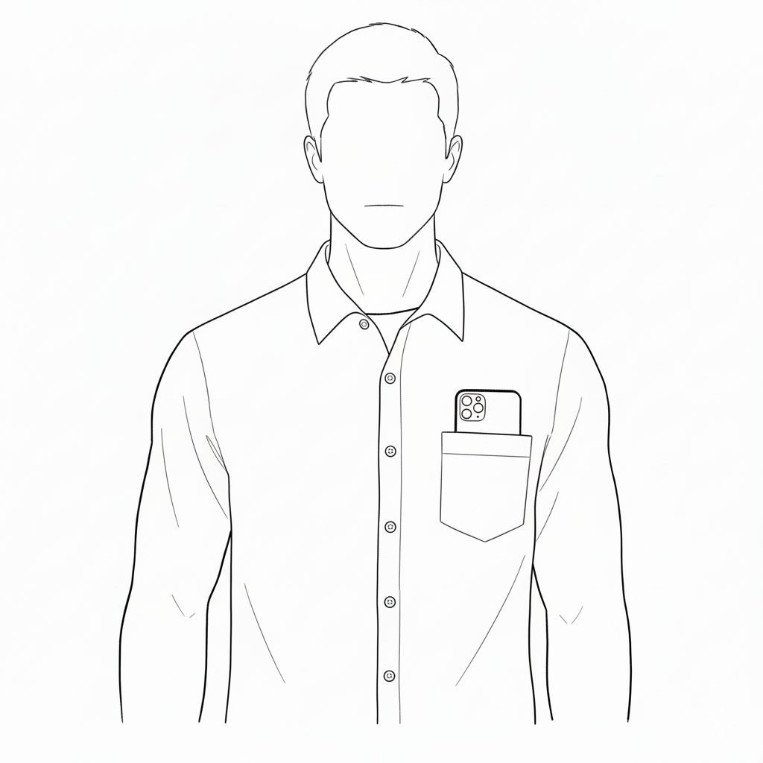
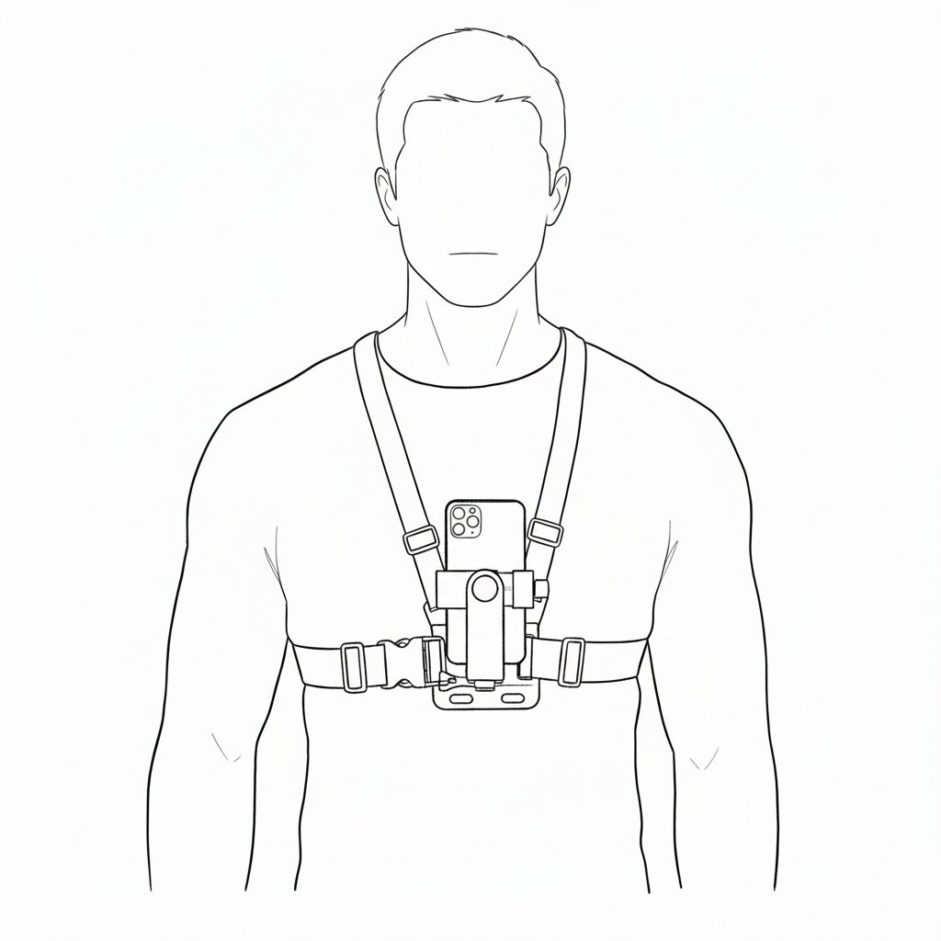
Project Idea
General Idea
Use smartphone sensors to detect user posture
Develop a mobile app to monitor and identify posture patterns
Provide gentle nudges to encourage better sitting habits
Motivation
Promote healthier lifestyle habits through posture awareness
Address the growing concern of prolonged sitting in daily life

Slide 3





Project Plan
Phase 1
Phase 2
Phase 3
Feature Extraction and Modelling -
Completion by 25th of November
Literature Review, Setup and Teaser Video - Completion by 8th November
Data Collection & Data Preprocessing - Completion by 14th of November
Phase 4
Phase 5
Prototype Development, Integration and Evaluation -
Completion by 30th of November
Final Report - Completion by 7th of December
Phase 4
Phase 5

Slide 4
Preliminary Results
Idea selection
Multiple brainstorming sessions
Initial meeting with teaching assistant
Alignment sessions cadence
Twice a week
Literature review
Identified related work
Initial prototype
Medium fidelity
Digital (Software) prototype

Slide 5
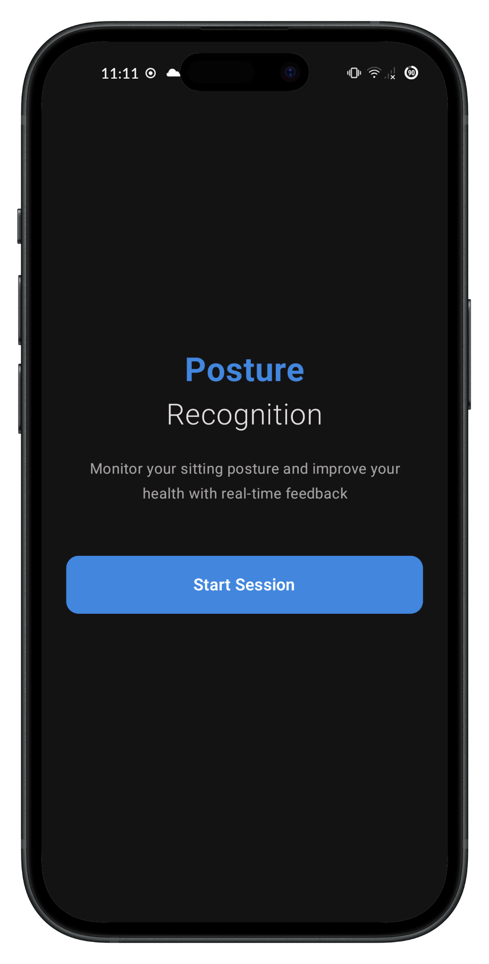
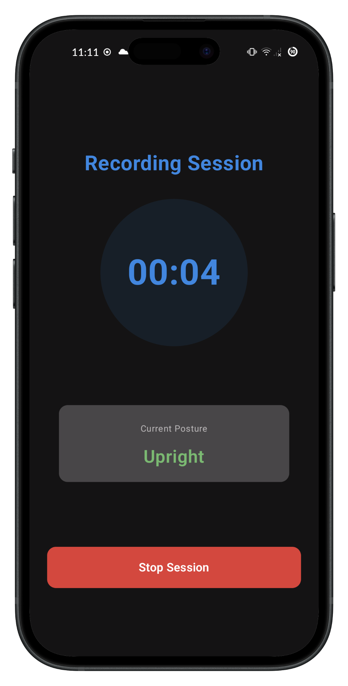
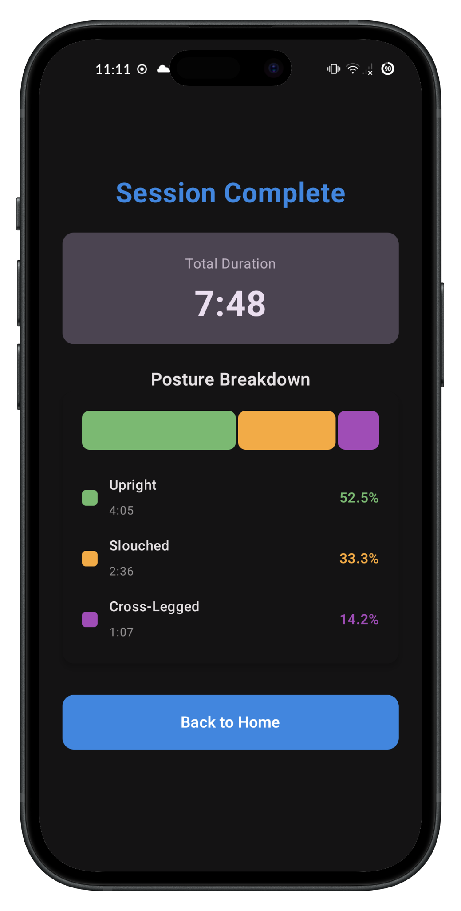
Initial Prototypes

Slide 6
Expected Outcome
Solidify Understanding
Study Principles of MUC
Understand Concepts of MUC
Identify Challenges of MUC
Data and Model
Collect and label posture data, followed by preprocessing
Develop and evaluate an ML model for posture recognition
Mobile App
Build a mobile application prototype integrated with the ML model
Test and refine the app for usability and accuracy
Documentation
Document project process and findings
Share insights for future research and development

Slide 7
Thank You
Group 28
Breejesh, Domnica, Japheth, Neel

Slide 8
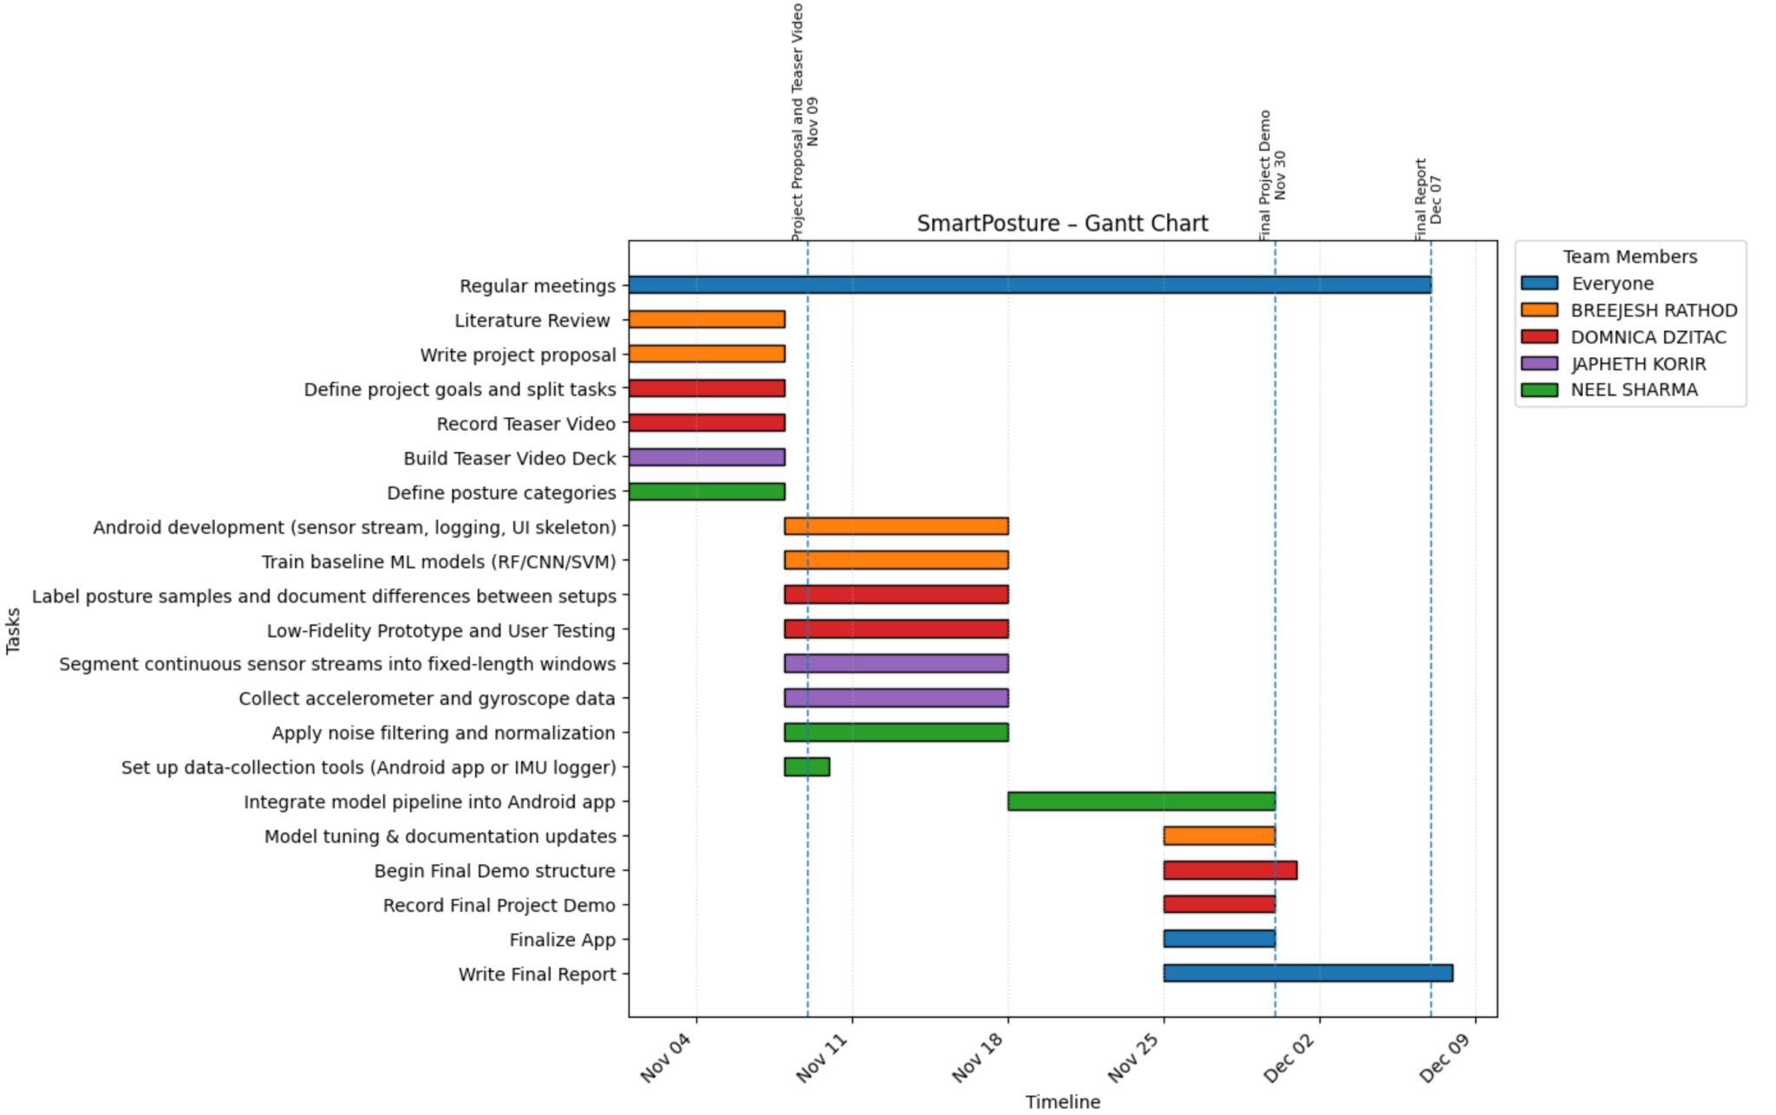
Project Plan
Phase 5

Slide 9
Project Idea
Aims and Objectives
Purpose To develop a smartphone-based system that delivers feedback to help individuals maintain healthy sitting posture habits.
Mechanism Identify key sitting posture classes using smartphone sensors and ML Models and deliver real-time feedback.

Slide 10
Project Idea
Main text – Navy Roboto 24px.
Example of a sub point. 18px Roboto
Subpoint example
Sub-sub point example the first
And the second

Slide 11

Project Plan
Ideation
Development
Results
Phasellus hendrerit facilisis nisi eget consequat. Donec vitae nunc risus. In eu augue aliquam, imperdiet est et, accumsan ante. Integer et vestibulum quam, nec varius urna. Pellentesque in ornare massa. Proin lobortis leo non lectus aliquam venenatis.
Phasellus hendrerit facilisis nisi eget consequat. Donec vitae nunc risus. In eu augue aliquam, imperdiet est et, accumsan ante. Integer et vestibulum quam, nec varius urna. Pellentesque in ornare massa. Proin lobortis leo non lectus aliquam venenatis.
Phasellus hendrerit facilisis nisi eget consequat. Donec vitae nunc risus. In eu augue aliquam, imperdiet est et, accumsan ante. Integer et vestibulum quam, nec varius urna. Pellentesque in ornare massa. Proin lobortis leo non lectus aliquam venenatis.

Slide 12
Preliminary Results
Main text – Navy Roboto 24px.
Example of a sub point. 18px Roboto
Subpoint example
Sub-sub point example the first
And the second

Slide 13
Expected Outcome
Main text – Navy Roboto 24px.
Example of a sub point. 18px Roboto
Subpoint example
Sub-sub point example the first
And the second

